Slide 1
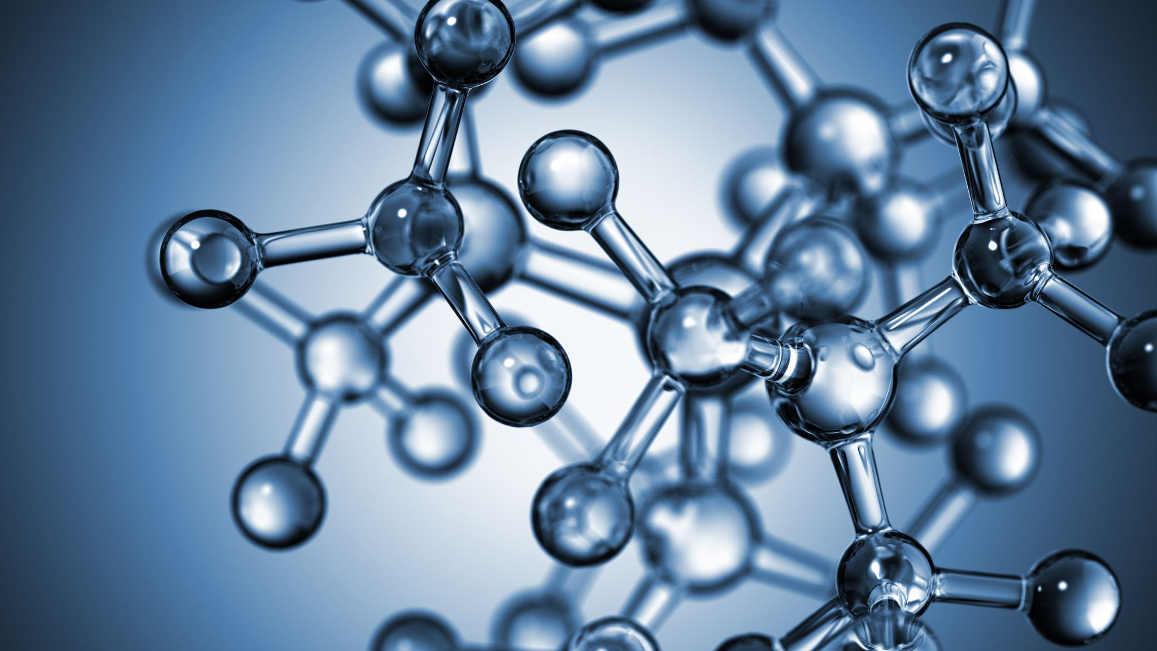


Mendeleev's periodic system. General overview of elements.
Al-Farabi Kazakh National University
Faculty of Chemistry and Chemical technology
Department of General and Inorganic Chemistry
pHd Bakhadur askar

Slide 2
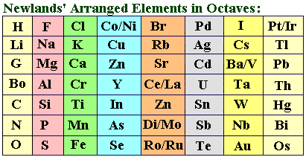
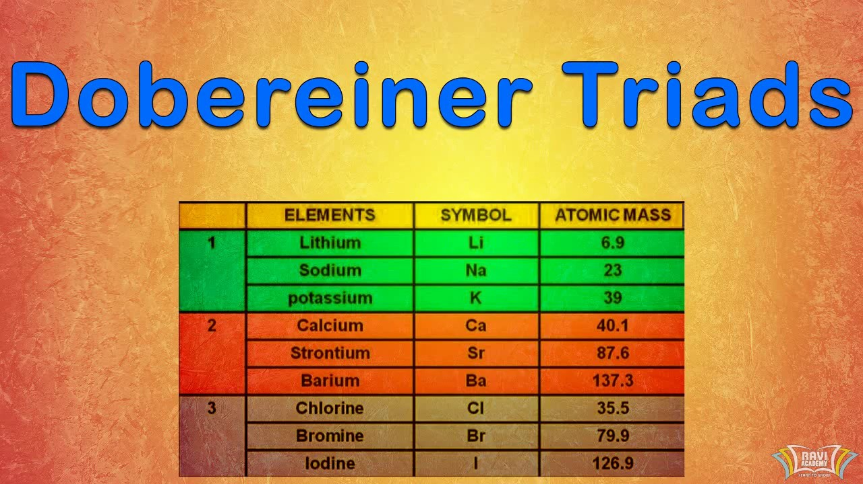
Historical background
Before Mendeleev’s discovery, chemists sought to organize elements according to their chemical and physical properties. Early attempts included:
Dobereiner’s Triads (1829): Grouped elements in sets of three based on similar properties.
Newlands’ Law of Octaves (1864): Proposed periodic repetition every eight elements. However, these systems failed to predict unknown elements accurately. The true breakthrough came in 1869, when Dmitri Ivanovich Mendeleev developed a systematic table based on atomic masses and recurring chemical behavior.

Slide 3

Mendeleev’s periodic law
Mendeleev proposed the Periodic Law:
“The properties of the elements are a periodic function of their atomic masses.” He arranged 63 known elements in rows (periods) and columns (groups) so that elements with similar properties aligned vertically. Crucially, Mendeleev left gaps for elements not yet discovered (e.g., gallium, scandium, germanium) and predicted their properties with remarkable accuracy. This predictive power validated his periodic system.

Slide 4
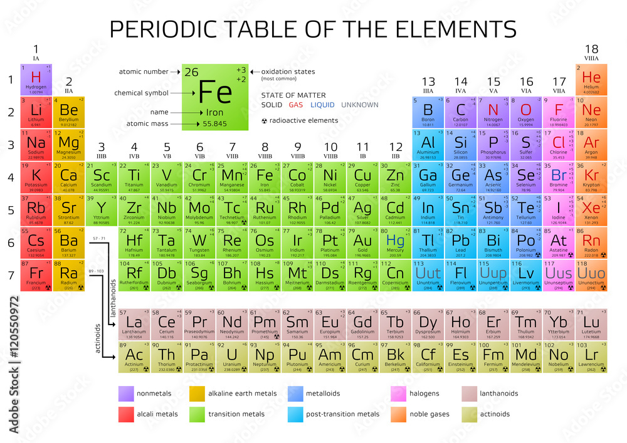
Features of Mendeleev’s table
Mendeleev’s original table organized elements by increasing atomic mass, but also prioritized chemical similarities.
Each horizontal period showed gradual changes in properties.
Each vertical group contained elements with related valencies and reactivity. He sometimes reversed the order of elements (e.g., Te and I) to preserve property alignment — an early hint that atomic number, not mass, determined periodicity.

Slide 5
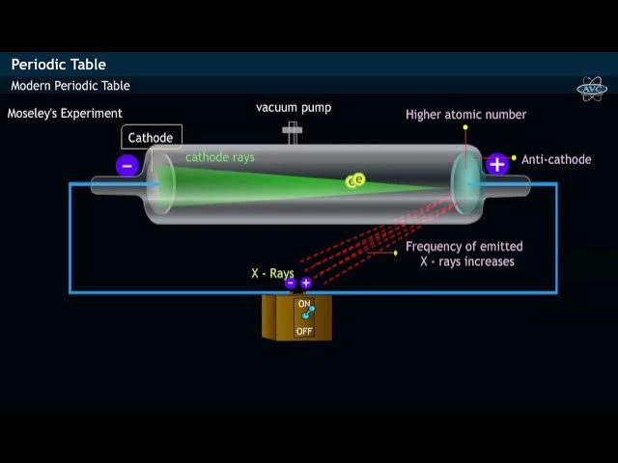
Discovery of atomic number
In 1913, Henry Moseley demonstrated that atomic number (the number of protons) — not atomic mass — defined the element’s identity. Moseley’s experiments using X-ray spectra led to the modern periodic law:
“The physical and chemical properties of the elements are periodic functions of their atomic numbers.” This corrected earlier anomalies and established the modern periodic table that remains the foundation of chemistry today.

Slide 6

The modern periodic table
Modern periodic tables are arranged by increasing atomic number (Z), not mass. Key structural features:
7 periods (horizontal rows)
18 groups (vertical columns)
4 major blocks based on electron configuration:
s-block: Groups 1–2
p-block: Groups 13–18
d-block: Transition metals (Groups 3–12)
f-block: Lanthanides and actinides (inner transition metals)
This arrangement reflects periodic recurrence in valence electron configurations, which dictate chemical behavior.

Slide 7
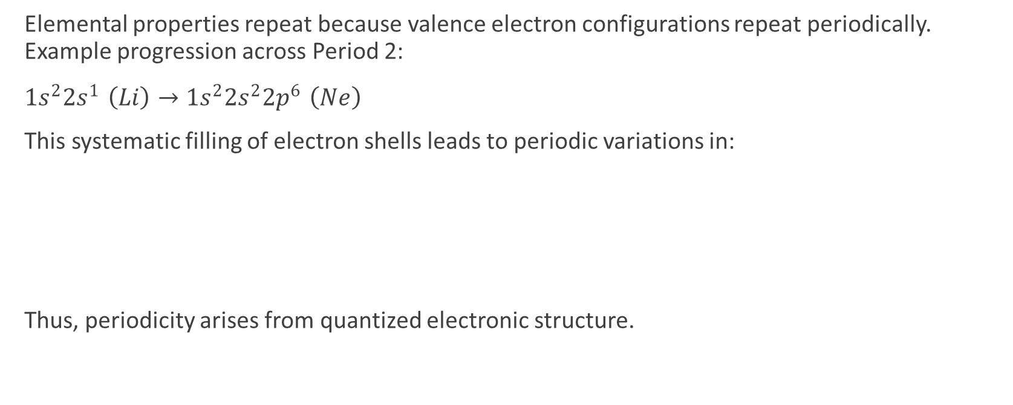
Electronic structure and periodicity
Elemental properties repeat because valence electron configurations repeat periodically. Example progression across Period 2:
$1s^{2}2s^{1} \left(Li\right)→1s^{2}2s^{2}2p^{6} \left(Ne\right)$
This systematic filling of electron shells leads to periodic variations in:
Thus, periodicity arises from quantized electronic structure.
Atomic and ionic radii
Ionization energy
Electronegativity
Metallic and nonmetallic character

Slide 8
Classification of elements
s-block elements: Highly reactive metals (e.g., Na, Ca); low ionization energies.
p-block elements: Nonmetals, metalloids, and some metals (e.g., C, O, Al, Cl).
d-block elements: Transition metals with variable oxidation states and colored ions.
f-block elements: Lanthanides and actinides with complex electron configurations and magnetic properties.
Each block corresponds to the type of orbital being filled by valence electrons.

Slide 9
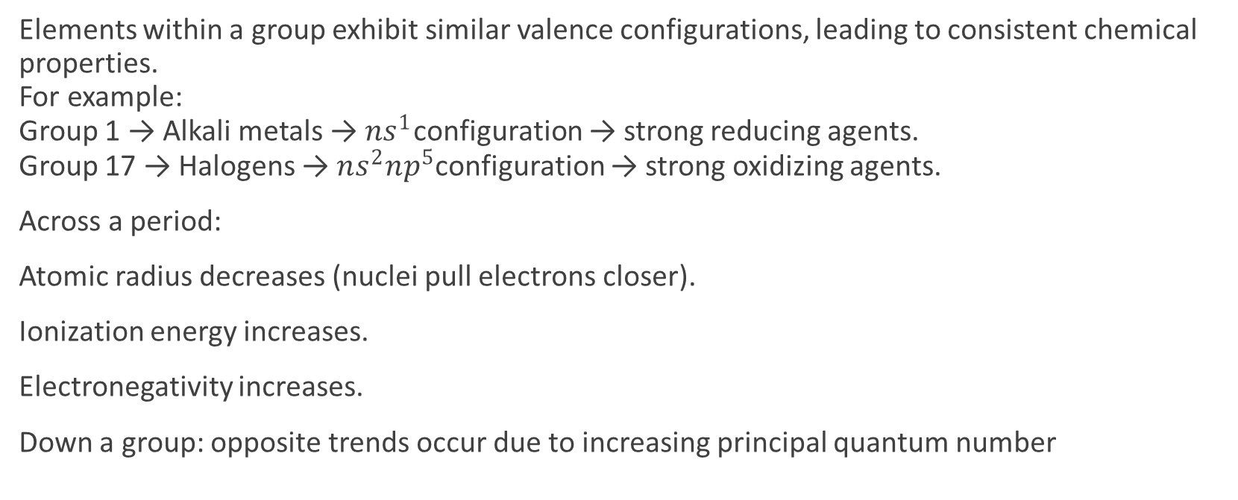
Groups and periodic trends
Elements within a group exhibit similar valence configurations, leading to consistent chemical properties. For example: Group 1 → Alkali metals → $ns^{1}$configuration → strong reducing agents. Group 17 → Halogens → $ns^{2}np^{5}$configuration → strong oxidizing agents.
Across a period:
Atomic radius decreases (nuclei pull electrons closer).
Ionization energy increases.
Electronegativity increases.
Down a group: opposite trends occur due to increasing principal quantum number

Slide 10
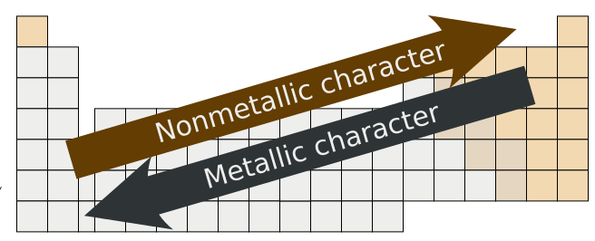
Metallic and nonmetallic character
Metallic character increases down a group and decreases across a period.
Metals: Good conductors, malleable, form basic oxides.
Nonmetals: Insulators, brittle solids or gases, form acidic oxides.
The diagonal from Boron to Astatine separates metals from nonmetals — the metalloid line (B, Si, Ge, As, Sb, Te). This gradual transition reflects continuous change in electron attraction strength.

Slide 11
Oxidation states and chemical reactivity
Periodic trends also influence the oxidation states and reactivity of elements.
s-block: fixed oxidation states (+1, +2).
p-block: multiple oxidation states due to variable ns and np electron participation.
d-block: wide range due to (n–1)d and ns interactions.
Reactivity trends:
Metals → more reactive down a group.
Nonmetals → more reactive up a group (especially halogens).
Mendeleev’s system accurately captured these periodic variations before electron theory existed.

Slide 12
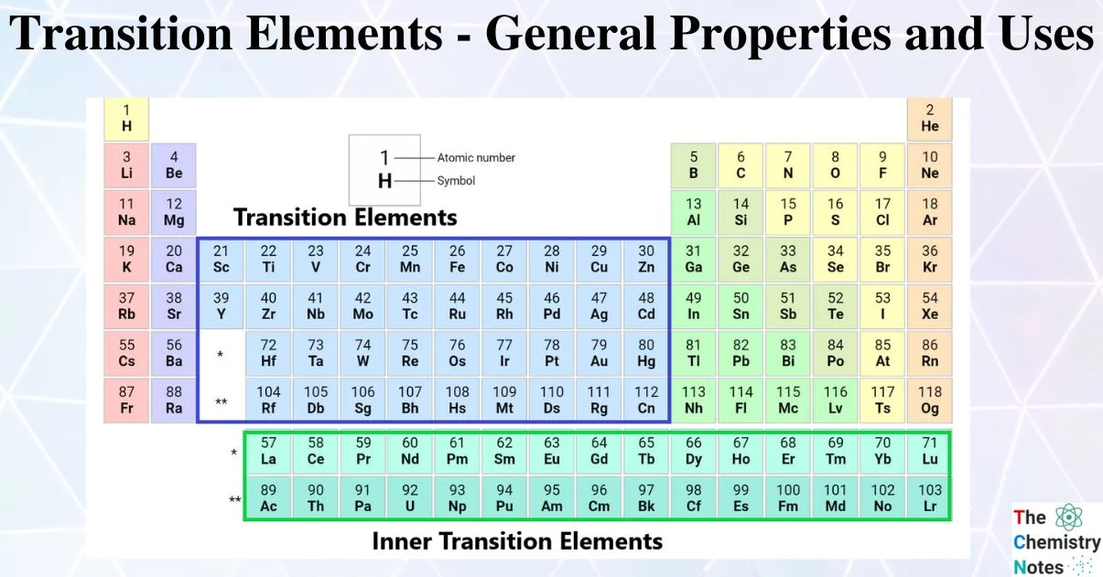
Transition and inner transition elements
Transition metals (d-block) show characteristic properties:
Variable oxidation states
Formation of colored compounds
Complex ion formation
Catalytic activity
Inner transition metals (f-block) — lanthanides and actinides — display similar ionic radii and reactivity due to shielding effects of 4f and 5f orbitals. They are critical in nuclear, magnetic, and photonic technologies.

Slide 13
Significance of Mendeleev’s system
Mendeleev’s table was revolutionary because it:
Organized known elements systematically.
Predicted undiscovered elements (e.g., aluminum → gallium).
Explained chemical periodicity before atomic theory was complete.
Provided the foundation for modern chemical classification, bonding theory, and quantum chemistry.
His insight demonstrated the unity of matter and the predictive power of scientific reasoning.

Slide 14
Application
Modern periodic studies extend Mendeleev’s work into:
Synthetic elements (Z > 100) in the actinide and transactinide series.
Periodic trends in atomic and ionic radii, ionization energy, and electron affinity.
Computational chemistry uses periodic relationships to predict new materials and reaction mechanisms.
The table remains an indispensable tool in education, research, and materials design.

Slide 15
The periodic table as a universal framework
The periodic system is more than a chart — it is a conceptual framework connecting all areas of chemistry and physics. It unites the microscopic world of atomic structure with the macroscopic properties of matter. From predicting compound stability to designing semiconductors and pharmaceuticals, the periodic table continues to guide scientific discovery.

Slide 16
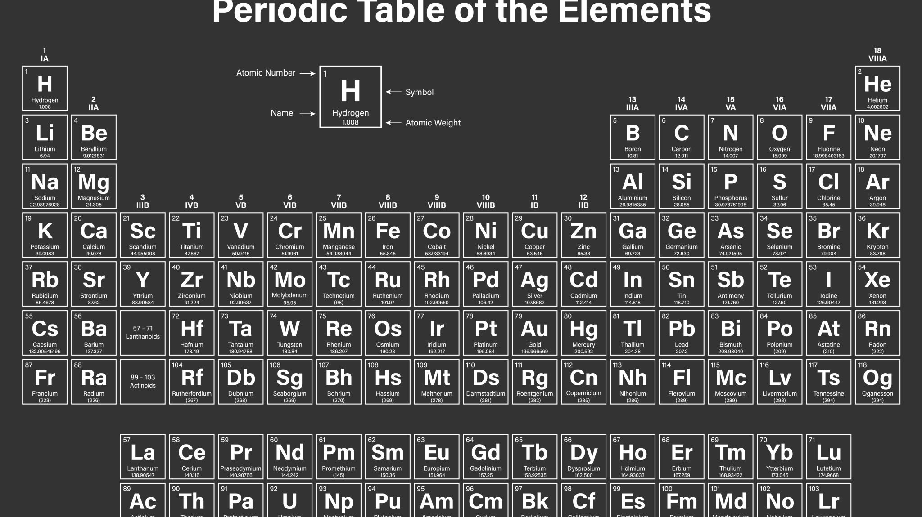
Summary
Mendeleev’s periodic law established a structured view of the elements based on periodic recurrence of properties.
Modern periodic law refines this by relating periodicity to atomic number and electron configuration.
The table organizes elements into blocks and groups that reflect trends in size, energy, and reactivity.
Understanding these trends enables prediction of chemical behavior, bonding patterns, and material properties.
The periodic table, born from Mendeleev’s genius, remains the cornerstone of modern chemistry — a living document of the laws governing atomic structure, reactivity, and the unity of all matter.

Slide 17

Questions?

